Slide 1
Welcome to Envestors
MBEB Endorsement Services
13th April 2023

Slide 2

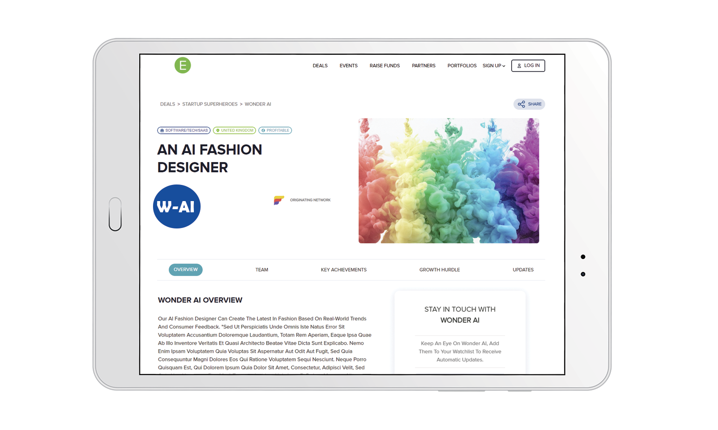
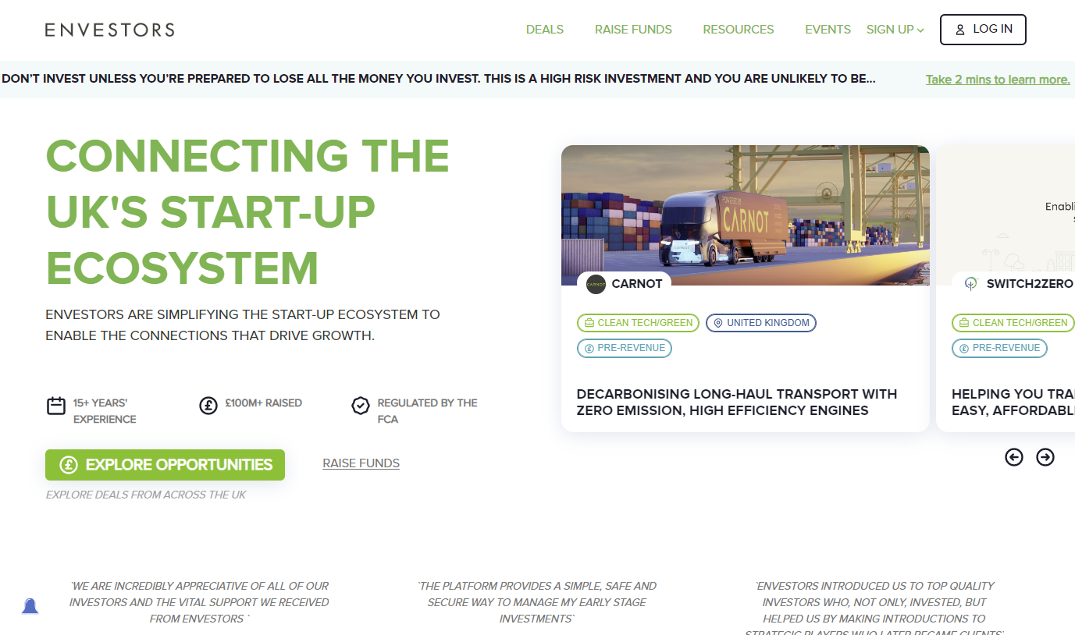
The Growth Marketplace for Innovative start-up & scale-up companies

Slide 3
Envestors is a UK based fintech company that facilitates the connections that drive entrepreneurial growth

Slide 4

The problem…
77% of start-ups fail to scale

Slide 5

Accelerators
The PROBLEM:
Mentors
The start-up ecosystem is disconnected
and
inefficient
Angel Clubs
Grants
Associations
Advisors
Funds
Incubators
Notes:
Chantelle

Slide 6








The Solution….
ANGEL CLUBS
START UPS
NEDS
Envestors start-up/scale-up growth ecosystem platform
INCUBATORS &
SUPPORT ORGS
SERVICE PROVIDERS
INVESTORS

Slide 7




Envestors connects the ecosystem and facilitates interaction with our SaaS tools
Startups
Navigate the ecosystem, gain exposure, raise funds, find NEDs, track engagement, get matched growth opportunities
Investors/NEDS
See all deals in the UK, conduct due diligence, invest, track portfolio Incubators, support orgs & angel Clubs
Manage portfolio, Increase visibility, generate leads, track success & better serve their communities
Service providers
Increase visibility, generate sales leads, track engagement & ROI

Slide 8
Track record of success
500+
Businesses established and accelerated
£100m+
Funds raised for start-ups
14,000+
Investors, Mentors, Growth Partners

Slide 9





Example Success Stories
2008
£15.5m
£129m
Acquired by BP for £129m
£4m valn
Raised
Exited 2018
2009
£1.3m
£700m
Santander invested at $1bn valuation
£15m valn
Raised 2010
Valuation 2019
2005
£125k
£13.2m
Acquired by Capita for £50m
Founded
3 investors
3 investors (x77)

Slide 10
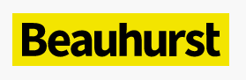





The leading start-up ecosystem platform in the UK
Envestors ranked
“Most Active Investment Platform in UK”
Legacy Endorser since Jan. 2020
Approved Visa Endorser
Six year contract (2023-29)
Member
Fully regulated by FCA (UK)
Founding Member
3-times winner
Notes:
Scott

Slide 11


Envestors has endorsed c.300 Innovator & Start-Up applicants to date.

Slide 12

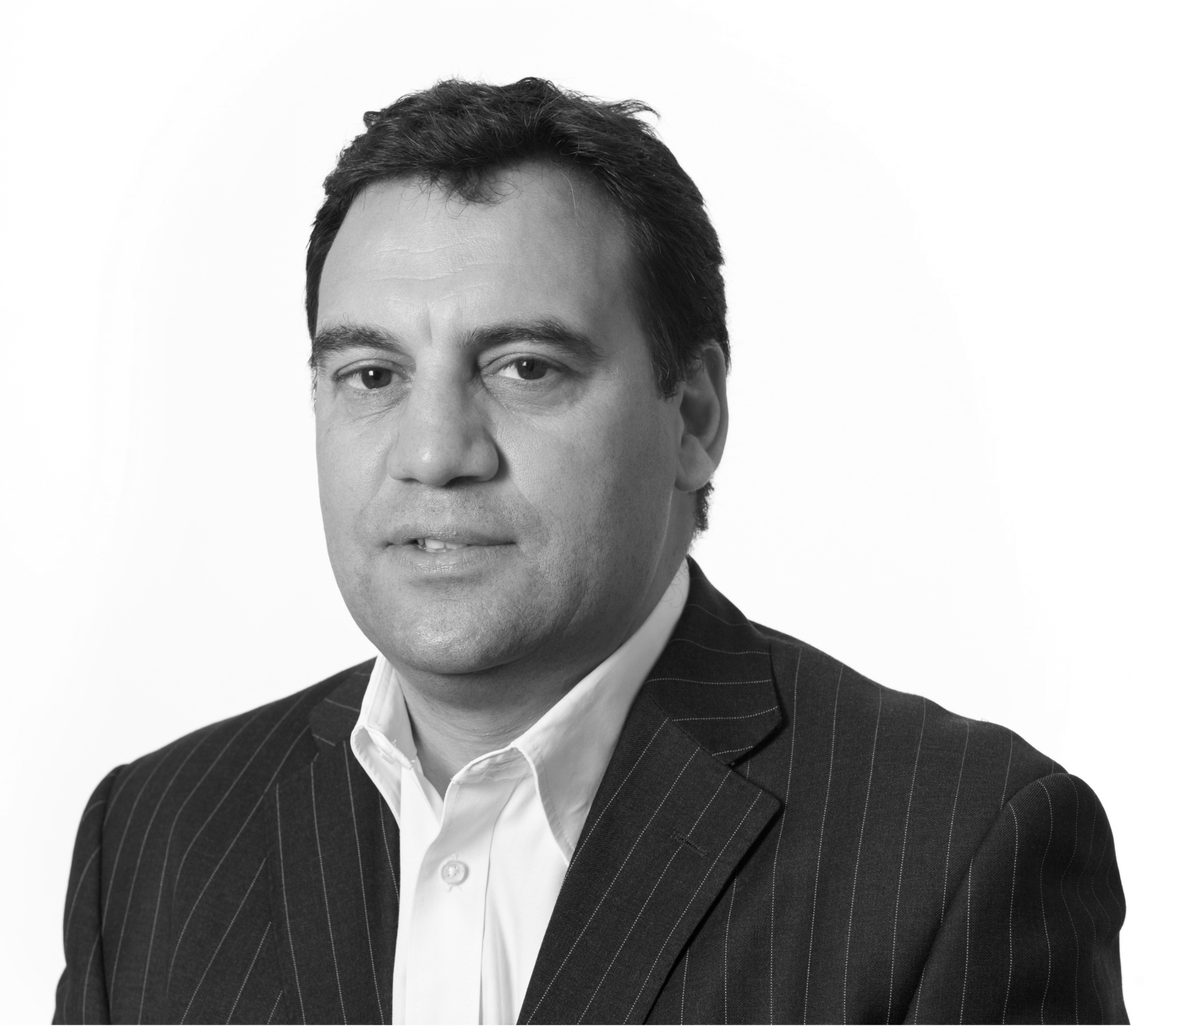




The Envestors Endorsement Team
Scott Haughton
Co-Founder,
COO & Director
Joel Drake
Senior Investment
Manager
Doris Zhang
Investment Manager
Katrina Petersone
Investment Manager
Jenny Teng
Investment Manager
Legacy Clients
Iman El Sherif
Investment Manager
Legacy Clients

Slide 13

Britbots is an investment fund that backs bold entrepreneurs that have established start-ups in the areas of robotics, AI, automation and electrification.
The fund has supported over forty businesses to-date, including companies run by founders on the Innovator Visa scheme.
Britbots is a delivery partner to Envestors
www.britbots.com

Slide 14
Innovator Business Founder Visa
Endorsement Process

Slide 15
Innovator Founder Endorsement Process
Applicants register via our online referral platform
Issued terms and pay mandatory fee (non-refundable)
In-person or online meeting
AML/KYC
Complete Endorsement Specific Business Plan
Evaluation
Scorecard & Feedback
Endorsement or Rejection
Roadmap
Monthly monitoring and Checkpoint Reviews 12 & 24 month
36 month Endorsement Settlement or Extension

Slide 16
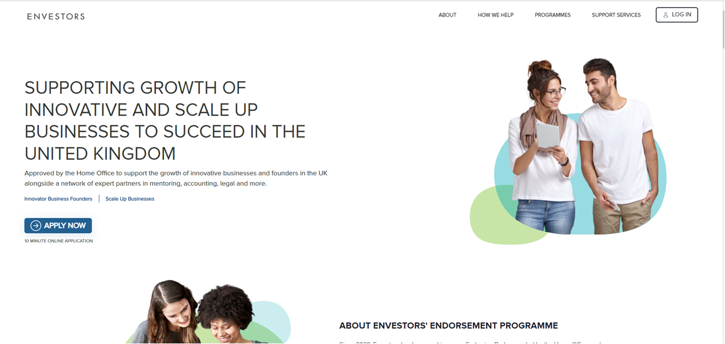
https://envestors-visa-endorsement.co.uk/

Slide 17
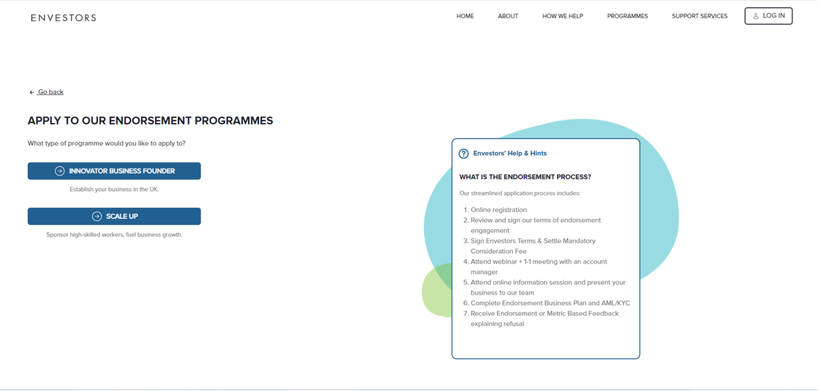

Slide 18
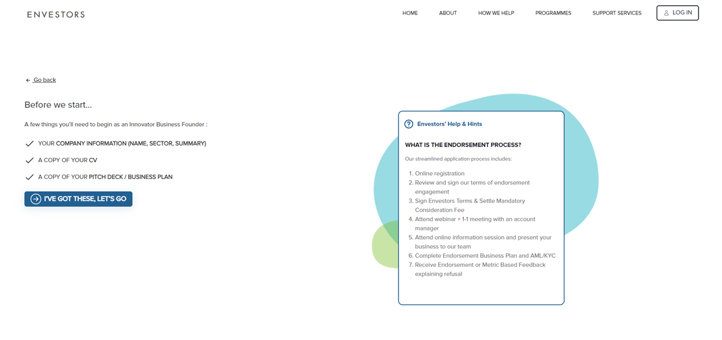

Slide 19
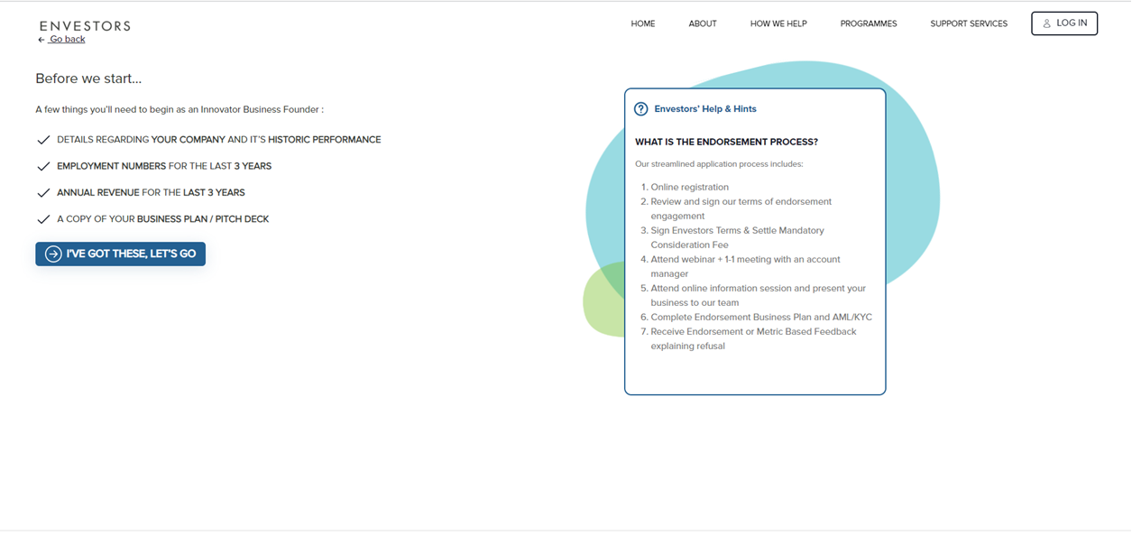

Slide 20

Innovator Business Founder – Terms & Mandatory Consideration Fee
Applicant issued Envestors formal endorsement terms
Applicant pays mandatory fee (£1,000 + Vat if in UK)
Non-refundable

Slide 21
Initial Endorsement Application Evaluation
Key Data Document (KIDD)
AML/KYC
  Innovative
  Viable
  Scalable
  Assessment & verification of start-up capital
Scorecard & Feedback
36 Month Roadmap
4 to 6 weeks
Facilitated by Envestors corporate finance team

Slide 22
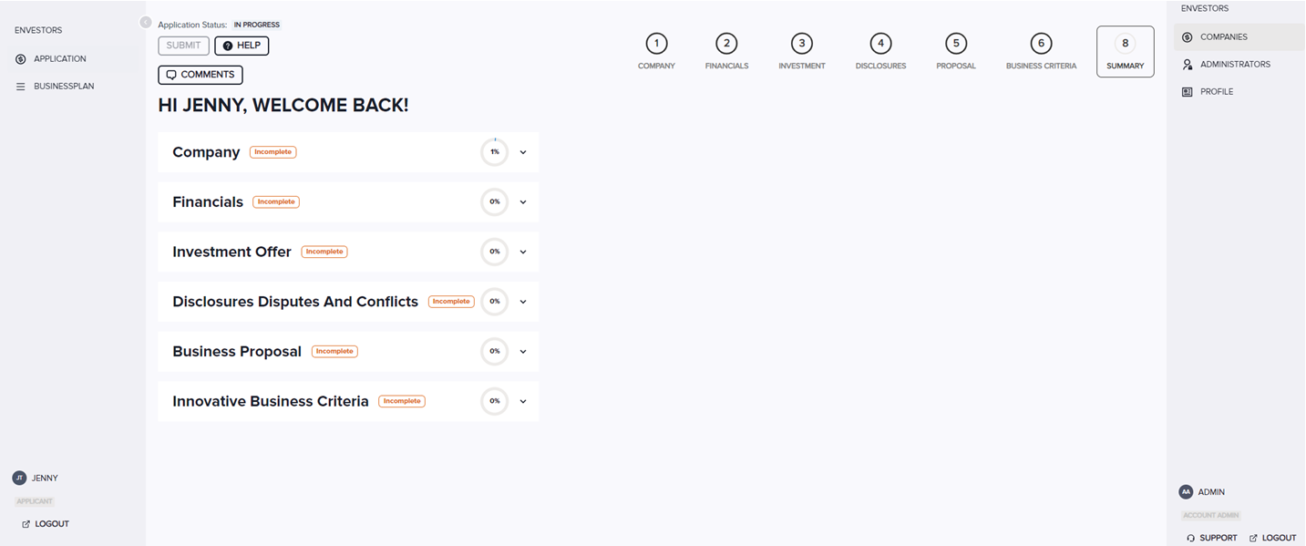

Slide 23

Monthly Monitoring
Reporting
  Requirement to submit Monthly Business Report
  Track progress and enables us to propose assistance and support

Slide 24

Checkpoint Reviews
Reporting
  Formal Home Office requirement
  Conducted at 12 and 24 monthly intervals
  Review progress versus Strategic Roadmap
  Agree actions and future objectives
  Official report submission to Home Office

Slide 25

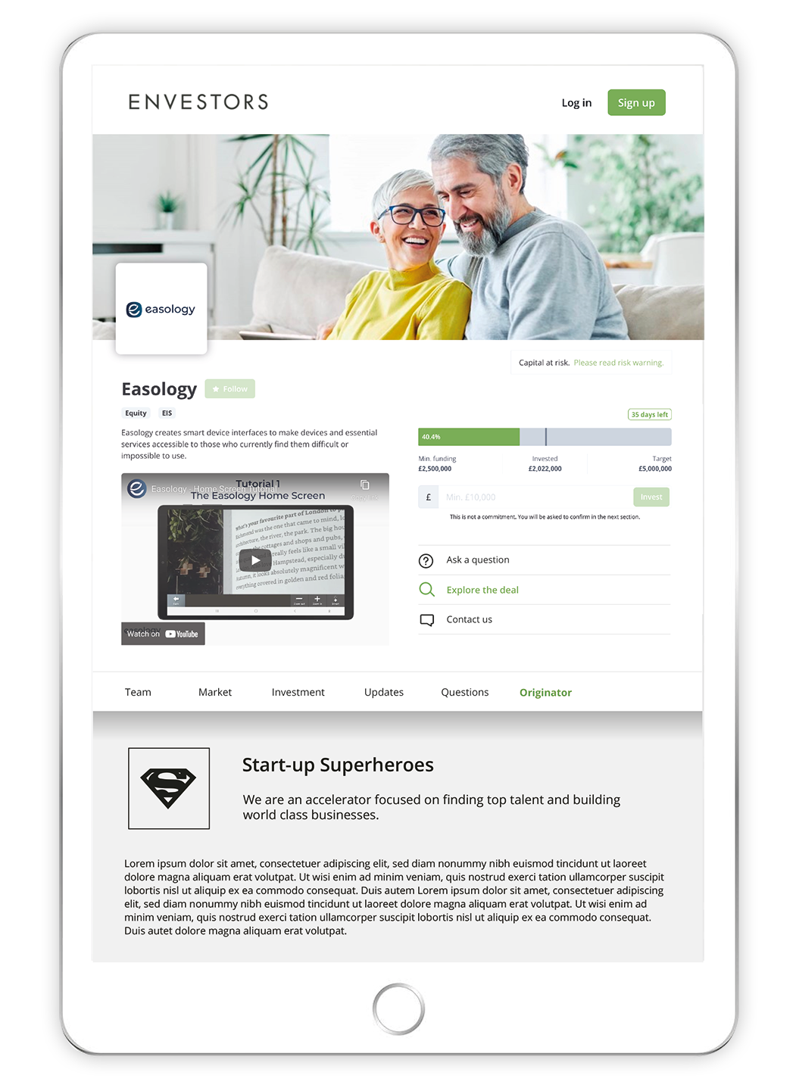
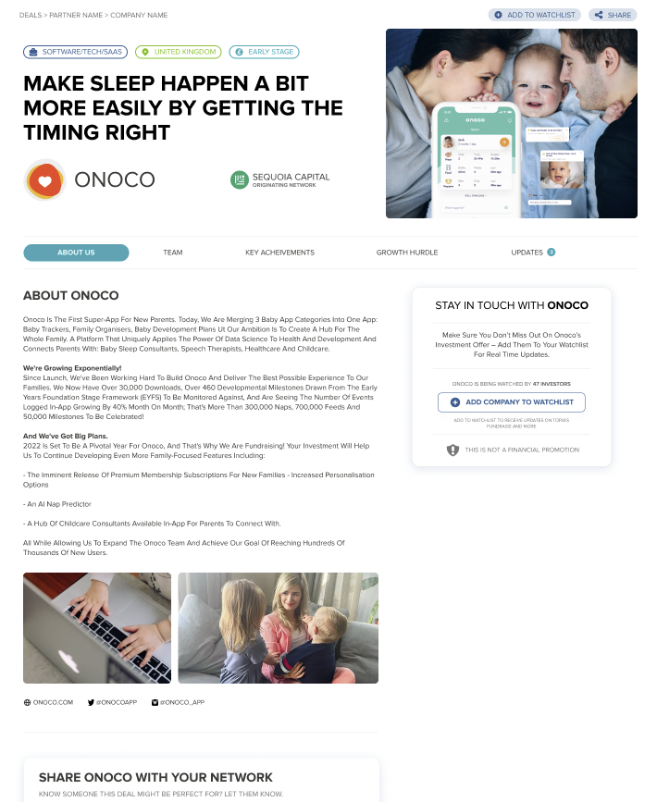




Basic Company Profile on Envestors Marketplace
Access resources, tools & informative content
Receive newsletters
Connect with service partners, mentors, investors
Drive business growth

Slide 26
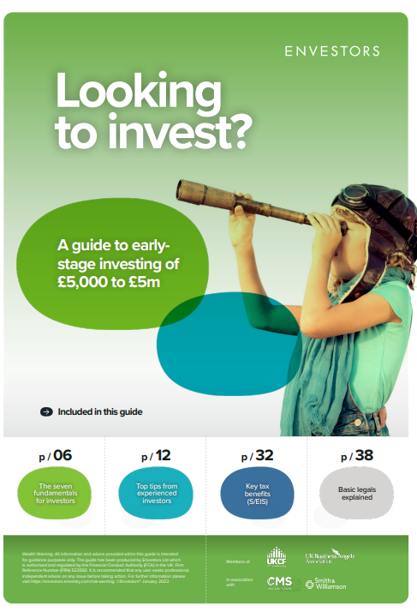

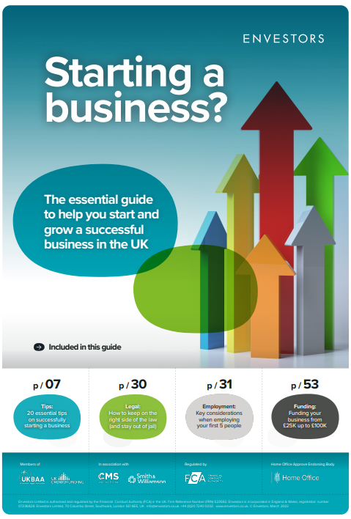
Inclusive Guidance

Slide 27

Further Endorsement
Innovator
  36-month assessment
  Verify criteria achievement - issue Endorsement for Indefinite Leave to Remain
  Evaluate progress made and assess future potential – issue Endorsement Extension for further 3 years

Slide 28

Optional Added Value Services

Slide 29

Facilitating a successful business
set up in the UK
Pre-Landing Support
Detailed assessment review of personal relocation requirements
  Relocation service (travel, logistics)
  Hotel/temporary/permanent accommodation
  Educational consultancy
  Asset relocation

Slide 30

Facilitating a successful business
set up in the UK
Landing & Set Up Support
  Set-up planning review
  Introductions to key trusted service partners
    Bank account
    Corporate Lawyer
    Workspace
    Web/IT
    Recruitment
    Patent/IP
    Marketing
    Asset relocation

Slide 31

Company Formation & Accountancy Service
  Registered company address
  Company registration
  Company secretarial
  VAT registration
  HMRC Payroll registration
  Corporate tax registration
  National Insurance application
  Set-up book-keeping software/system
  Prepare & submit quarterly & annual Statutory Accounts, Corporation Tax and Companies House Filings
  Personal tax filing

Slide 32
Providing regular Advice, Support &
Guidance
Mentoring
  1 hour touch-point mentoring per month
  Valuable sounding-board/guidance
  Flexible resource

Slide 33

Fundraising Support
  Formal Business Valuation
  FCA Regulatory Sign-Off
  Marketing to Envestors Private Investor Club
  Targeted search & introductions to VC’s, family offices, private investors

Slide 34

Ongoing Compliance
Ensuring visa maintenance and success
  Introductory one hour call with Independent Compliance Consultant – assess issues, personal needs and key milestones
  Annual audit of business progress, criteria achievement, verification/validation, paperwork
  Range of virtual & in person advisory support

Slide 35
Rich Company Profile on Envestors Marketplace
Access resources, tools & informative content
Receive newsletters
Connect with service partners, mentors, NED’s
Conduct fundraising, access investors
Join industry sub-groups
Attend quarterly networking events
Drive business growth

Slide 36

Envestors Translation &
Language Services
  Comprehensive document Translation Services (multi-languages)
  Interpretation
  English Language Learning Courses, including IELTS training

Slide 37

Envestors Bespoke Strategic Business Planning Support
  Comprehensive business planning assessment and training
  Fully customisable 36-month Strategic Planning Roadmap
    Establish and flex milestones
    Manage resource allocation effectively & efficiently
    Track progress achievement
    Evidence a track record of achievement

Slide 38

Envestors Real Estate
Service
Optional Service & Extra Cost
  Utilisation of a highly experienced real estate Director
  Access to high quality apartments and houses for purchase or rental
  Comprehensive service – tailored search, viewings, negotiation through to completion
  Allows you to focus on establishing your business

Slide 39









Business Services Referral Partners
Banking Services
Relocation Services
Accommodation

Slide 40






Business Services Referral Partners
Workspace Services
Grants
Payment
Asset Protection,
Personal Tax, Wills
Business Insurance

Slide 41





Business Services Referral Partners
IP/Trademark Services
Recruitment Services
Graphics/Design Services

Slide 42







Business Services Referral Partners
Marketing Services
App/Tech
Development
Services

Slide 43


Innovator Business Founder Visa: Mandatory Costs
Application - £1,000 (+Vat if in UK)
Checkpoint Monitoring Reviews - £1,000 (+Vat) (£500 per 12mth & 24mth)
Settlement or Extension Endorsement - £1,000 (+ Vat)
Total: £3,000 (+Vat)

