Slide 1
Facilitating dialogue… instructions
When you get into the breakout, say hi and introduce yourselves and then agree who will speak 1st, 2nd, 3rd and 4th. Use a timer (phones out), with a loud alarm to limit inputs to no more than 90 secs…
There could be a spectrum of experience…feel free to borrow any of these sentence stems to get you started:
“I’m new to sustainability/climate, something I’m thinking about now is…
“I’ve been developing my thinking/practice in this area, one thing I can share is…
“We have a well established [project/module/workshop etc], and we do…
“A question I have is….
Go round twice (2 x max 90 secs), so each person will have up to 3 mins to share what they’re thinking/doing/etc… feel empowered to borrow/build from each other… “Like Alison, I think that…
We offer some thinking time now so you can write down what you might want to comment on, share, question, etc…
Notes:
CB

Slide 2
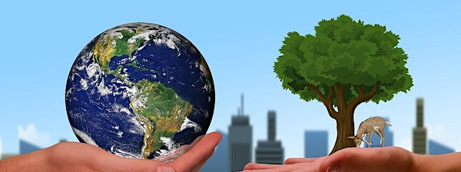
Climate Action for EE Educators – Influencer Strategy
Catherine Brentnall, Curriculum Lead for Enterprise Education, University of Huddersfield.
David Higgins, Senior Lecturer, University of Liverpool.
Notes:
2 mins
CB, introductions, aims/shape of the session

Slide 3
Project activities…
Planning, expert interviews….
Scholarly Output (3e):
“EE in a time of climate and ecological breakdown”
Tool Kit, presentations assets
Connecting to a dialogic perspective
Dissemination: May 19th
August 2022
July 2022
Recruiting for the workshops
Workshops in Hud and Liv
Dissemination: EEUK Exchange
Scholarly Output (Book Chapter)
Develop and test a workshop/process to influence our practice/EE towards sustainability…
Notes:
2 mins
CB –

Slide 4
Dialogic activities – signposted dialogic mindset
Dialogic mindset
(Bushe and Marshak, 2012, 2014, 2016, 2018, Holman, 2010, 2013).
Processes and mindset which prioritises connecting with people and facilitating future focused dialogue to generate new ways forward.
Coherence – Disruption - Emergence
Notes:
2 mins
CB – Dialogic approach

Slide 5
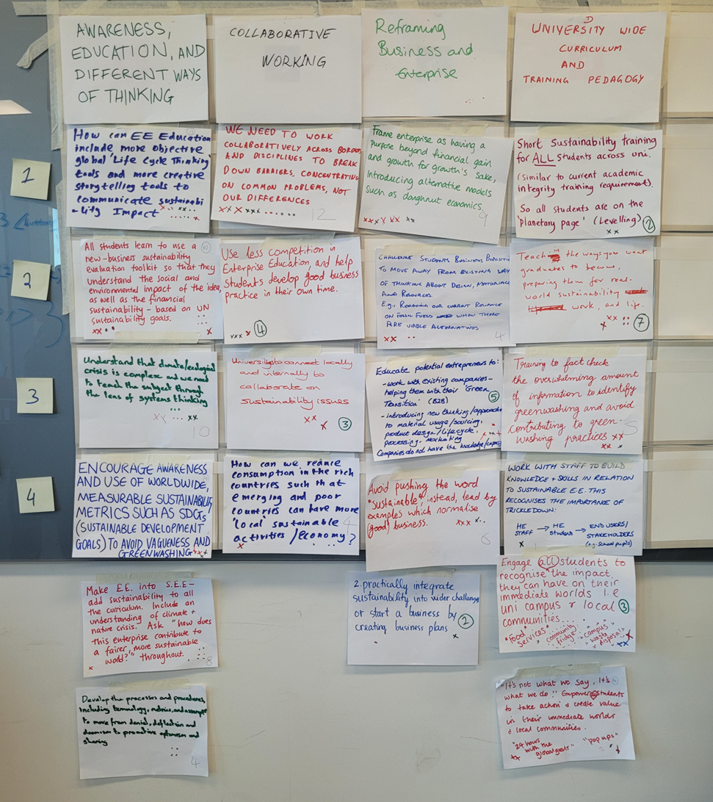
Generating ways forward…
Notes:
2mins
David

Slide 6
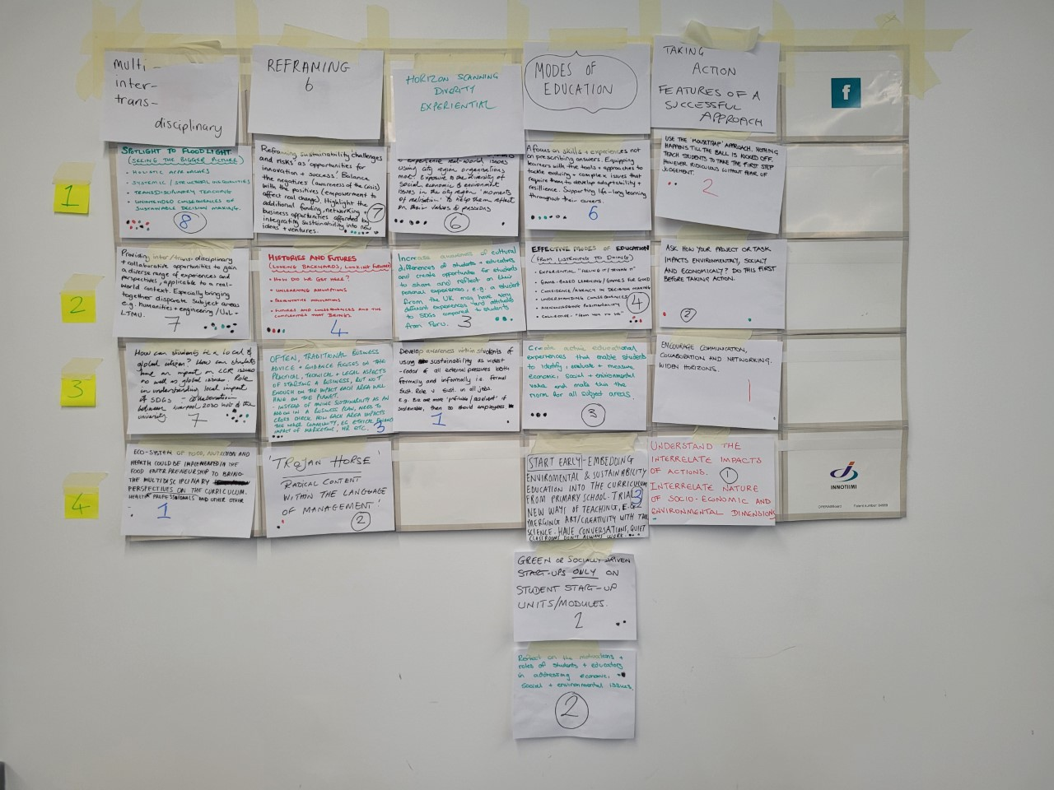
Generating ways forward…
Notes:
2 mins
David

Slide 7
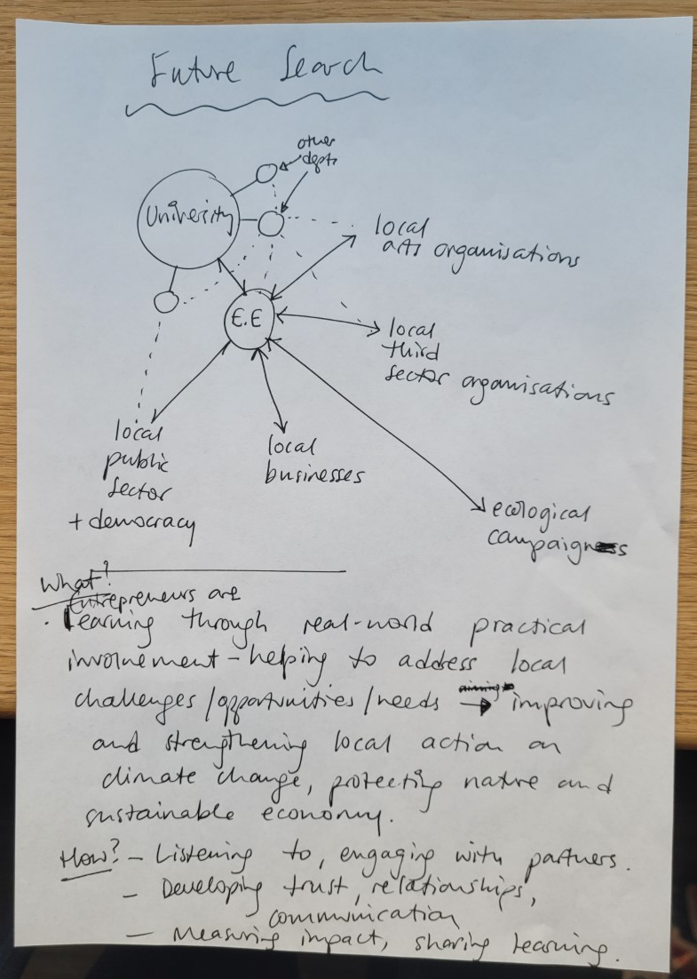
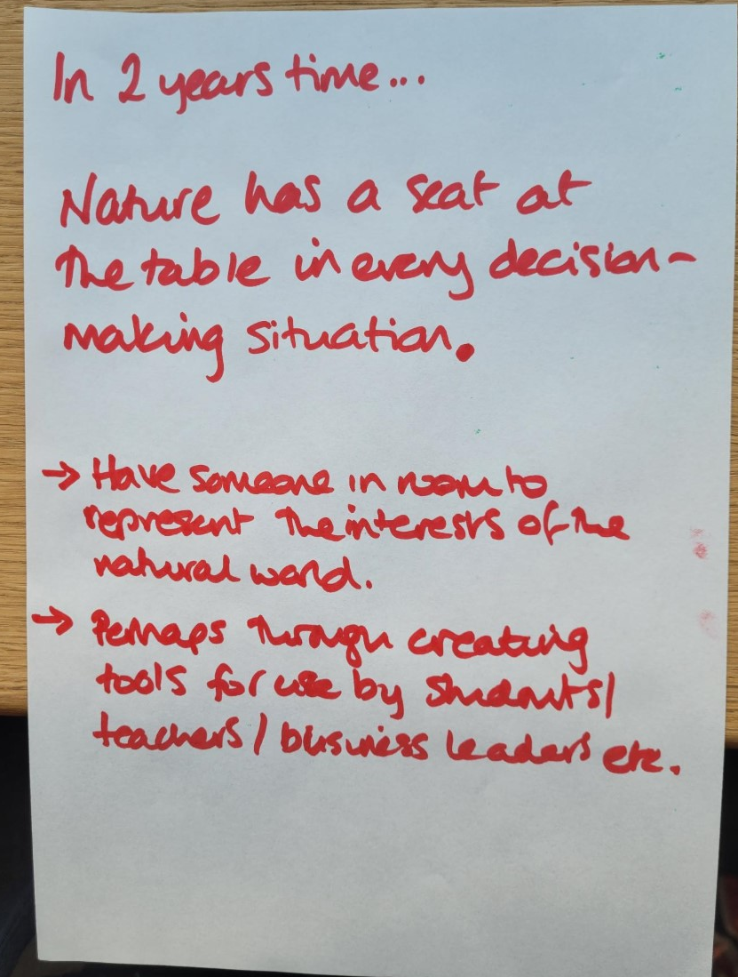
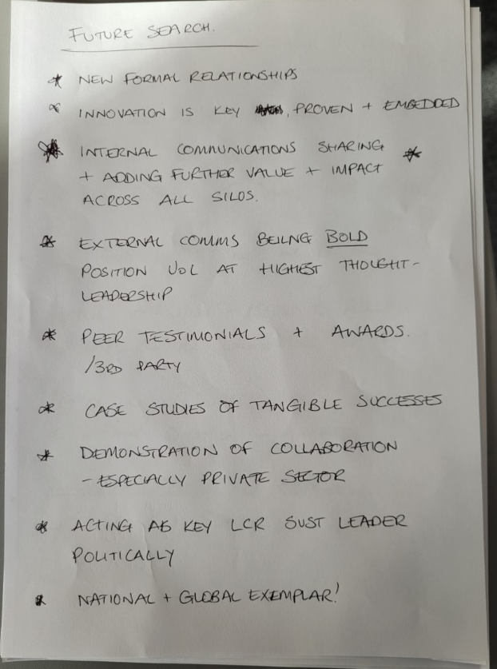
Searching the future
Notes:
2 mins
David

Slide 8
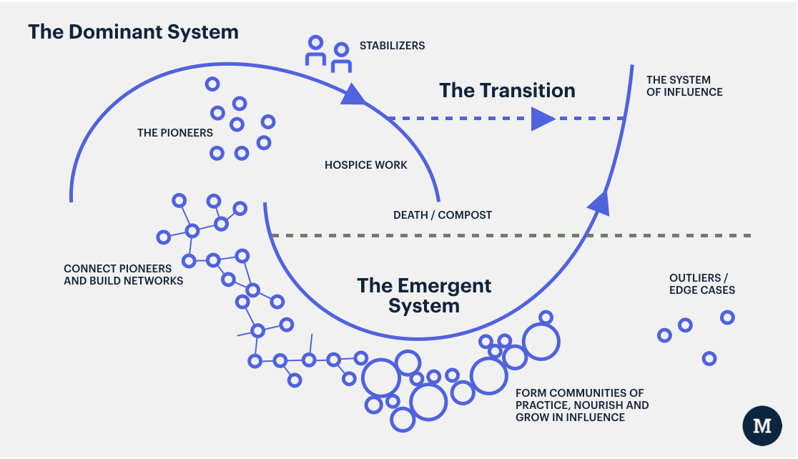
How does change happen?
Figure: The Two Loops Model and System Change interpreted by The Moment https://www.themoment.is/how-change-happens/, also, see the original paper by Wheatley and Frieze from the Berkana Institute: https://berkana.org/resources/pioneering-a-new-paradigm/
Notes:
2 mins
CB – two loops model and change in times of crisis. What’s emerging?
David – what’s emerging?

Slide 9
Save the date
Enterprise and Entrepreneurship Education: climate tipping points and social tipping points.
Fri May 19th (1 – 4pm GMT).
Connect:
c.brentnall@hud.ac.uk
dhiggins@liverpool.ac.uk
Notes:
30 secs
CB

Slide 10
To cite
Brentnall, C. and Higgins, D. (2023, March 28th), EEUK Exchange: Climate Action for Enterprise and Entrepreneurship Educators: Influencer Strategy [online seminar].

